Slide 2
Thank you Pastor for inviting me to participate in your
41^{st.} WORLD MISSIONS CONFERENCE 2022
It is always my pleasure and honor to be there with you and your people whom I miss and love so dearly.

Slide 4
The theme of this Missions Conference is
“Faithful to the
Old Fashion
Method of Missions”
Or could I say this?
“Let us get back to being FAITHFUL TO THE OLD FASHION METHODS OF MISSIONS.”

Slide 5
“Faithful to the
Old Fashion
Method of Missions”
Could I say this?
“We need to begin being faithful and follow what God has written in the BIBLE about missions.”
The BIBLE is our only authority on this subject.

Slide 6
Our Bible Institutes, at the begging in 1982, spent some time and wrote up a “Mission Statement” to let our teachers, students and people know our goals, what we wanted to achieve, our values, standards and philosophies.
In short,
WHAT WAS THE MISSION OF OUR BIBLE INSTITUTES?
We were to train men and women
for the ministry. That was our MISSION, our MAIN PURPOSE.

Slide 7
Our theme is: “Faithful to the Old Fashion
Method of Missions”
When we think of “Old Fashion” we have to think of the word “beginning”.
When was the beginning of “Old Fashion Missions”?

Slide 8
When was the beginning of “Old Fashion Missions”?
“In the beginning God created the…..” Genesis1:1-25
Gen 3:14 “And the LORD God said unto the serpent, Because thou hast done this, thou art cursed above all cattle, and above every beast of the field; upon thy belly shalt thou go, and dust shalt thou eat all the days of thy life:”
Gen 3:6 “And when the woman saw that the tree was good for food, and that it was pleasant to the eyes, and a tree to be desired to make one wise, she took of the fruit thereof, and did eat, and gave also unto her husband with her; and he did eat.”
Gen 2:22 “And the rib, which the LORD God had taken from man, made he a woman, and brought her unto the man. 23 And Adam said, This is now bone of my bones, and flesh of my flesh: she shall be called Woman, because she was taken out of Man.”
“The man, Adam” Gen. 2:7
Gen. 2:7 “And the LORD God formed man of the dust of the ground, and breathed into his nostrils the breath of life; and man became a living soul.”
“The woman, Eve” Gen. 2:22
“They sinned” Gen. 3:6
“The curse” Gen. 3:14

Slide 9
When was the beginning of “Old Fashion Missions”?
“The curse” Gen. 3:14
“The Promise Is Given” Gen. 3:15
“And I will put enmity between thee and the woman, and between thy seed and her seed; it shall bruise thy head, and thou shalt bruise his heel.”

Slide 10
When was the beginning of “Old Fashion Missions”?
“The Promise Is Given” Gen. 3:15
“And I will put enmity between thee and the woman, and between thy seed and her seed; it shall bruise thy head, and thou shalt bruise his heel.”
“I (God) am declaring war between you (Satan) and the Woman (Mary), between your (Satan) offspring and hers (Mary). He (Jesus) will wound your (Satan) head, you (Satan) will wound his (Jesus) heel.”

Slide 11
When was the beginning of “Old Fashion Missions”?
This is PROPHECY. Gen. 3:15
“And I will put enmity between thee and the woman, and between thy seed and her seed; it shall bruise thy head, and thou shalt bruise his heel.”
PROPHECY means to foretell. To have knowledge of the future.

Slide 12
The PROPHECY. Gen. 3:15
This PROPHECY was fulfilled in
Matthew 1:18 “Now the birth of Jesus Christ was on this wise: When as his mother Mary was espoused to Joseph, before they came together, she was found with child of the Holy Ghost.”
Matthew 1:21 “And she shall bring forth a son, and thou shalt call his name JESUS: for he (JESUS) shall save his people from their sins.”
Jesus’ mission was to save
the world from their sins.

Slide 13
WHAT SHOULD BE OUR MAIN MISSION IN LIFE?
LET US GO TO THE BIBLE AND LEARN WHAT GOD’S WORD SAYS ABOUT THIS.
WHAT WAS JESUS MAIN MISSION?
Matt. 1:21 “And she (Mary) shall bring forth a son, and thou shalt call his name JESUS: for he shall save his people from their sins.”
Luke 2:49 “And Jesus said unto them, (His parents) How is it that ye sought me? wist ye not that I must be about my Father's business?”

Slide 14
Romans 5:8 “But God commendeth (showed) his love toward us, in that, while we were yet sinners, Christ died for us.”
THE MAIN MISSION IN THE LIFE OF JESUS CHRIST WAS
NOT TO HEAL THE SICK, OR MAKE THE LAME TO WALK OR RAISE THE DEAD. JESUS DID THAT, BUT THAT WAS NOT HIS MAIN BUSINESS OR MISSION IN LIFE.
THE MAIN MISSION IN THE LIFE OF JESUS CHRIST WAS TO
SEEK AND TO SAVE PEOPLE WHO ARE LOST AND ON THEIR WAY TO AN ETERNAL HELL.
That was the beginning of “Old Fashion Missions”

Slide 15
That was the beginning of “Old Fashion Missions”
Jesus was the first missionary. He came from Heaven to this wicked world to save people from their sins.
JESUS WAS THE FIRST MISSIONARY.
That is not the end of the story.
WHAT ABOUT JESUS’ DISCIPLES:
Mark 3:14 “And he (Jesus) ordained twelve, that they should be with him, and that he might send them forth to preach.” Preach what? The Gospel.

Slide 16
WHAT ABOUT JESUS’ DISCIPLES:
Mark 1:16-20 “Now as he (Jesus) walked by the sea of Galilee, he saw Simon and Andrew his brother casting a net into the sea: for they were fishers.
And Jesus said unto them, Come ye after me, and I will make you to become fishers of men. And straightway they forsook their nets, and followed him.
him. And when he had gone a little farther thence, he saw James the son of Zebedee, and John his brother, who also were in the ship mending their nets.
nets. And straightway he called them: and they left their father Zebedee in the ship with the hired servants, and went after him.” (They followed Jesus)

Slide 17
JESUS COMMAND TO HIS DISCIPLES:
Mark 16:15 “And he said unto them, Go ye into all the world, and preach the gospel to every creature.”
Matt. 28:19 “Go ye therefore, and teach all nations, baptizing them in the name of the Father, and of the Son, and of the Holy Ghost: 20 Teaching them to observe all things whatsoever I have commanded you: and, lo, I am with you alway, even unto the end of the world. Amen.”

Slide 18
JESUS’ PROMISE:
Acts 1:8 “But ye shall receive power, after that the Holy Ghost is come upon you: and ye shall be witnesses unto me both in Jerusalem, and in all Judaea, and in Samaria, and unto the uttermost part of the earth.”
LOOK WHAT THE DISCIPLES DID:
Acts 17:6 “…the rulers of the city, crying, These (Disciples) that have turned the world upside down ….”

Slide 19
LOOK WHAT THE DISCIPLES DID:
Acts 4:4 “Howbeit many of them which heard the word believed; and the number of the men was about five thousand.”
Acts 19:18 “And many that believed came, and confessed, and shewed their deeds.”
Acts 18:8 “And Crispus, the chief ruler of the synagogue, believed on the Lord with all his house; and many of the Corinthians hearing believed, and were baptized.”
Romans 10:17 “So then faith cometh by hearing, and hearing by the word of God.”

Slide 20
We saw the promised Prophecy of the first Missionary in Genesis 3:15
We saw that Prophecy was fulfilled in Matthew 1:18
We saw where Jesus called men to become fishers of men.
We read in the book of Acts how these disciples went throughout the known world witnessing to people, preaching the Gospel and planting New Testament Churches.

Slide 21
Let’s “fast forward”
Down throughout these many years, God has raised up men who have carried on the
“The Old Fashion
Method of Missions”
Quickly, let me give you a short history lesson since 1980

Slide 22
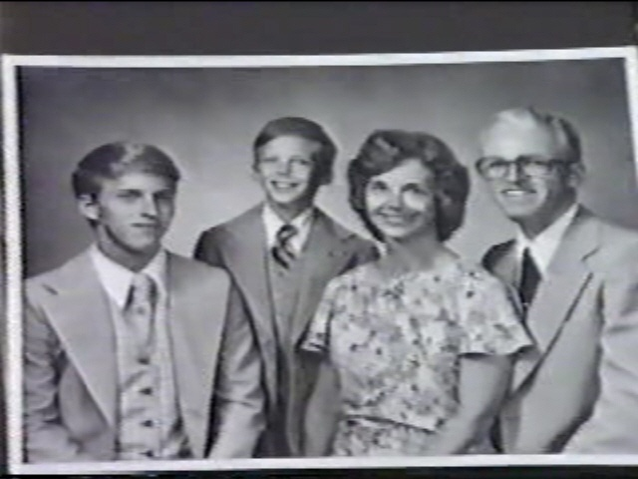
Let’s see what God has accomplished since 1980.
FROM A HUMBLE BEGINNING
WITH ONLY A VISION OF
PLANTING ONE CHURCH.
OUR FAITH WAS VERY SMALL
BUT LOOK WHAT OUR GOD
HAS DONE!
The Brown family arrived in
the Philippines on July 1, 1980

Slide 23
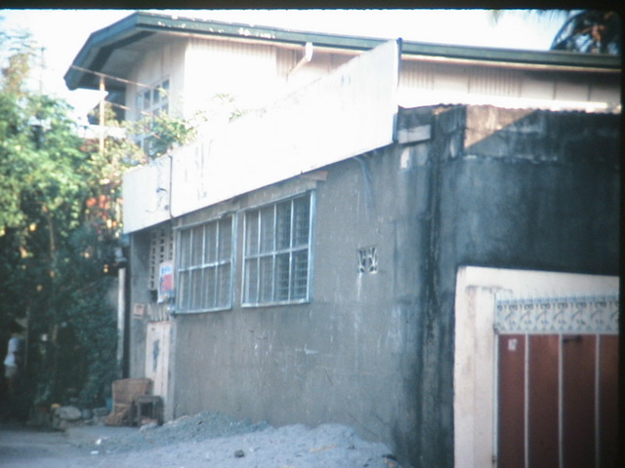
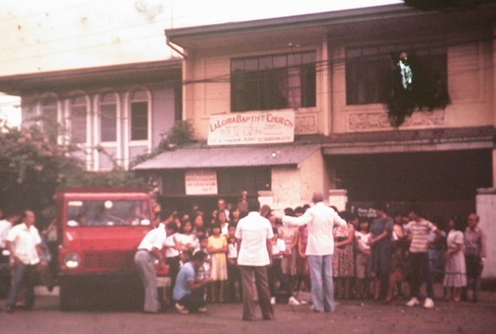
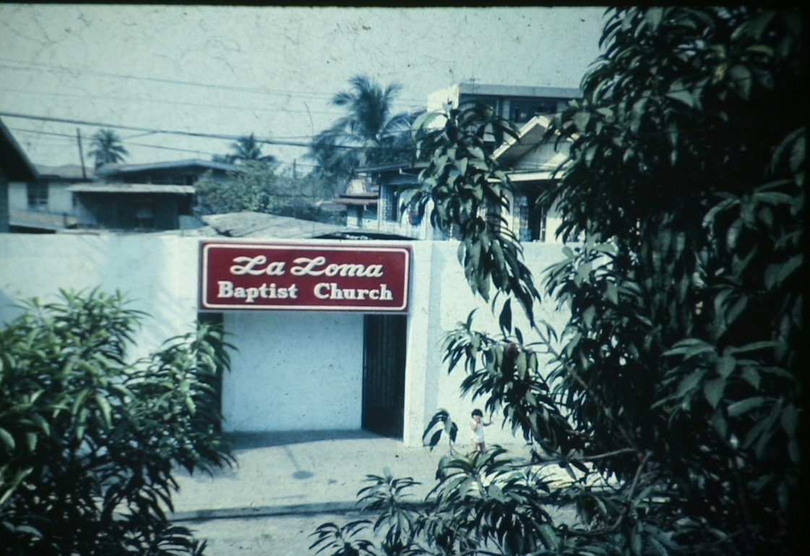
We organized LBC in this place
on Sept. 27, 1980
First location – 1980 In a house, up stairs.
Our 2^{nd.} location – 1980 In a carport.
4^{th.} Location
133 Isarog St., LaLoma, Q.C.
1945 U.S. Army Quonset hut.
3^{rd.} location – 1980
In this apartment.

Slide 24
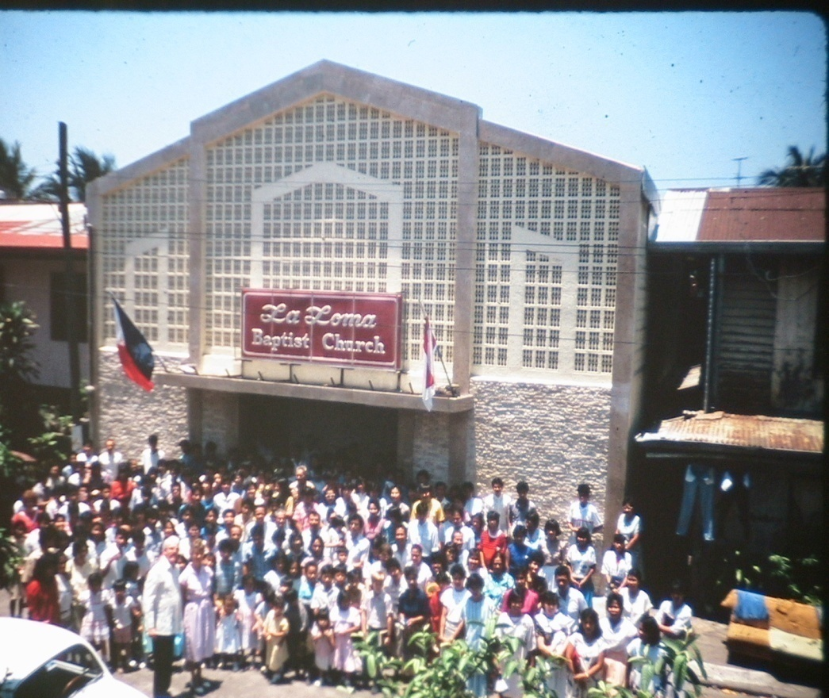
We built this building
over the Quonset hut.

Slide 25
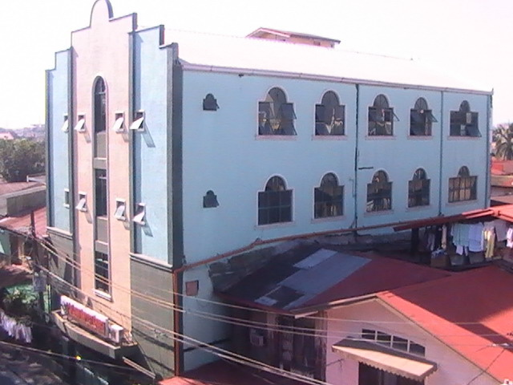
Built over this
building on right

Slide 26
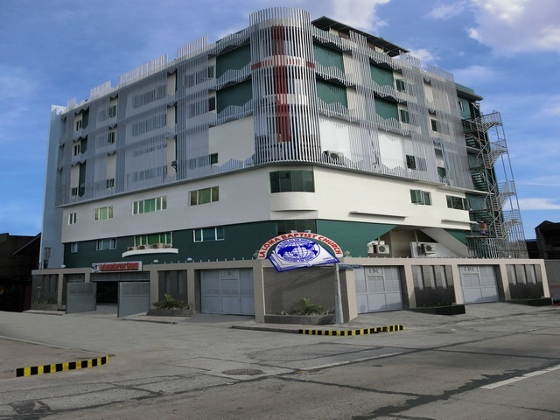
Our present location

Slide 27
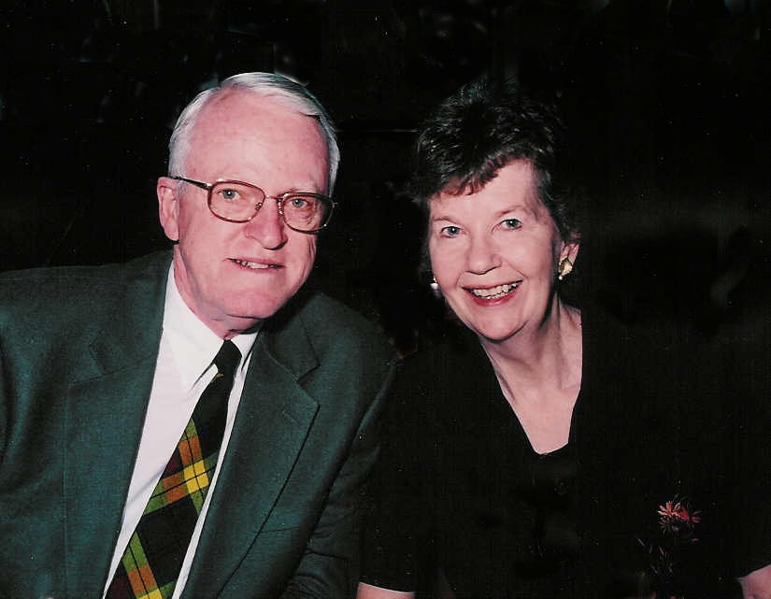
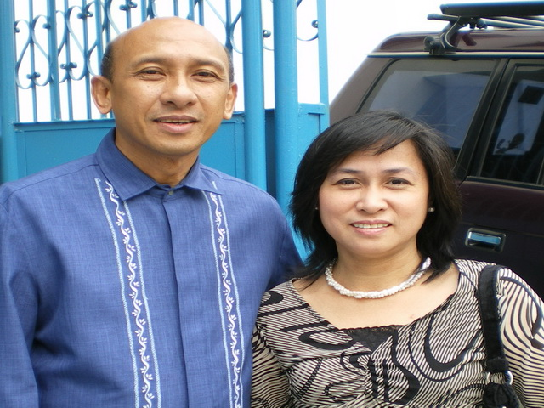
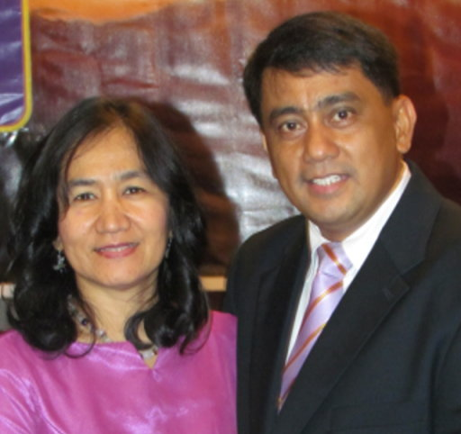
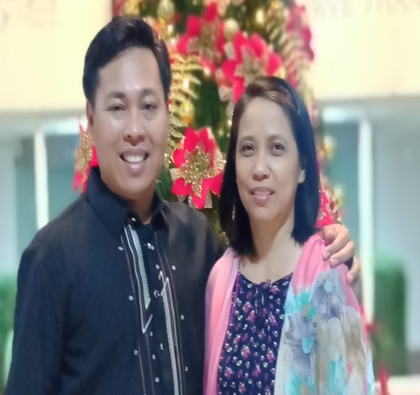
Founder
Pastor & Mrs. Melvyn Brown
1980-1987
1^{st.} National Pastor,
Pastor & Mrs. Estipona 1987-1996
Pastor & Mrs. Toquero
1996 – 2021
Pastor & Mrs. Ramil L. Olalia
2021-

Slide 28
THESE FOUR PASTORS HAVE KEPT THE ANCIENT LANDMARKS SINCE 1980
TO GOD BE
ALL THE GLORY
FOR WHAT HE HAS DONE!
HERE ARE SOME OF THE LANDMARKS AND
OLD-FASHIONED METHODS:

Slide 29
THE BIBLE, IS OUR ONLY SOURCE FOR FAITH AND PRACTICE.
We believe the Bible is the inspired and preserved
Word of GOD.
2. We only use the King James version in our church, Bible Institute, college, grammar and High School.
2 Tim. 3:16 “All scripture is given by inspiration of God, and is profitable for doctrine, for reproof, for correction, for instruction in righteousness:”
Matthew 24:35 Jesus said: “Heaven and earth shall pass away, but my words shall not pass away.”
3. The KJV is the authorize version. All others are unauthorized.

Slide 30
So, there are three groups of people within the
LaLoma Baptist Church.
The Pastor, he is our shepherd, teacher, etc., etc.
2. The Deacons, they are the servants, to the Pastor & members.
3. All members of LBC are
saved, baptized believers.

Slide 31
Here are the responsibilities
of the Pastor.
The Pastor is our shepherd and teacher of the Word of God.
The Pastor leads his sheep.
The Pastor feeds his sheep the Word of God, the Bible.
The Pastor loves and cares for his sheep.
The Pastor has to give an account to God for all his sheep.

Slide 32
Hebrews 13:17 “…for they (the Pastor) watch for your souls, as they (the Pastor) that must give account (to God), that they (the Pastor) may do it with joy, and not with grief: for that is unprofitable for you (the members).”

Slide 33
These are the responsibilities
of the members of LBC.
The members are to be faithful in their church attendance.
IT TAKES 3 TO THRIVE-Grow in grace
Heb. 10:25 “Not forsaking the assembling of ourselves together, as the manner of some is; but exhorting one another: and so much the more, as ye see the day approaching.”
1. Sunday morning – Sunday School.
2. Sunday afternoon service.
3. Wednesday Prayer time and Bible
Study.
If you really love the Lord you will be faithful in the above services.

Slide 34
These are the responsibilities
of the members of LBC.
2. The members are to be faithful in their church attendance.
3. The members are to pray for the Pastor and the church services.
4. The members are to listen
carefully to the sermons and obey.
Heb. 13:7 “Remember them (Pastor) which have the rule over you, who have spoken unto you the word of God: whose faith follow, considering the end of their conversation.”

Slide 35
Hebrews 13:17 “Obey them (the Pastor) that have the rule over you, and submit yourselves: for they watch for your souls, as they that must give account, that they may do it with joy, and not with grief: for that is unprofitable for you.”

Slide 36
OUR CHURCH IS NOT A SHOWCASE, BUT IS LIKE A HOSPITAL, REACHING LOST PEOPLE WITH THE GOSPEL OF JESUS CHRIST. BAPTIZING THEM, AND TEACHING THEM TO GROW IN GRACE AND REACHING OTHERS WITH THE GOSPEL.
Please remember this, we all, from the Pastor, Deacons, Staff, Teachers and members are prone to make mistakes that may offend you.
Count on it, it will happen.
WHAT SHOULD WE DO ABOUT IT
WHEN IT HAPPENS?

Slide 37
THIS IS WHAT WE SHOULD DO:
Eph. 4:24……32 “And be ye kind one to another, tenderhearted, forgiving one another, even as God for Christ's sake hath forgiven you.”
When you are offended: “forgive one another”
How do we forgive? “even as God for Christ's sake hath forgiven you.”
How does Christ forgive you?
1. Immediately
2. Completely

Slide 38
“Faithful to the
Old Fashion
Method of Missions”
1. We have started in Genesis 3:15
The Promise Given
2. We have gone to Matthew 1:18 & 21
The Promise Fulfilled
3. We have gone to Mark 1:16-20
The Disciples Are Picked
4. WE HAVE A MANDATE FROM JESUS
Matthew 28:19-20
The Great Commission - GO

Slide 39
WE HAVE A MANDATE FROM JESUS
Mat 28:19 “Go ye therefore, and teach all nations, baptizing them in the name of the Father, and of the Son, and of the Holy Ghost:
Verse 20 Teaching them to observe all things whatsoever I have commanded you: and, lo, I am with you alway, even unto the end of the world. Amen.”

Slide 40
WE HAVE A PROMISE FROM JESUS
Act 1:8 “But ye shall receive power, after that the Holy Ghost is come upon you: and ye shall be witnesses unto me both in Jerusalem, and in all Judaea, and in Samaria, and unto the uttermost part of the earth.”
GO here, there, next door, across the street, North, South, East or West.

Slide 41
Acts 1:9 “And when he had spoken these things, while they beheld, he was taken up; and a cloud received him out of their sight. And while they looked stedfastly toward heaven as he went up, behold, two men stood by them in white apparel; Which also said,….
Ye men of Galilee, why stand ye gazing up into heaven? this same Jesus, which is taken up from you into heaven, shall so come in like manner as ye have seen him go into heaven.”
JESUS IS COMING SOON!

Slide 42
WHAT ABOUT YOU?
WHAT IS YOUR MAIN MISSION?
WHAT ARE YOU DEDICATED TO?
WHERE IS YOUR PASSION?
WE KNOW WHAT GOD’S
MAIN MISSION IS.
GOD’S MAIN MISSION IS BRINGING PEOPLE INTO
A SAVING RELATIONSHIP WITH JESUS CHRIST.

Slide 43
“EVERY HEART WITHOUT CHRIST IS A MISSION FIELD.
EVERY HEART WITH CHRIST
IS A MISSIONARY.” (OR SHOULD BE)
John 20:21 “Then said Jesus to them again, Peace be unto you: as my Father hath sent me, even so send I you.”
Jesus told them, just before He ascended into heaven, “As my Father has sent me to this world to save sinners, now I am commanding you to GO and do the same thing.”

Slide 44
JESUS IS REALLY COMING SOON!
ARE YOU READY?
ARE YOU GETTING
OTHERS READY?
Pastor,
Would you please come
and give the invitation?

